Slide 1
Perimeter of composite shapes
Perimeter, area and volume

Slide 2
how to use Oak lessons

Slide 3
I can solve perimeter problems of composite shapes involving whole and/or part circles.

Slide 4
An arc is a part of a curve.
An arc of a circle is part of the circle’s circumference.
arc

Slide 5

Perimeter of composite shapes
Comparing arcs and perimeters of a sector
Finding perimeters of closed composite shapes

Slide 6

Comparing arcs and perimeters of a sector
The length around the outside of a circle is called a circumference.
But, there are two different options when considering the length created by a sector of a circle.
circumference =

Slide 7
Comparing arcs and perimeters of a sector
An arc length is the length of the curved part of a sector: a fraction of the circle’s circumference.
A perimeter of a sector includes both the arc length and the two radii that form the bounds of the sector.
arc length
radius
radius

Slide 8


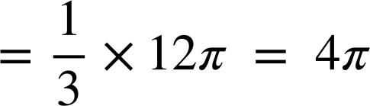


Comparing arcs and perimeters of a sector
Find the arc length and perimeter of one sector of this circle.
This arc is the length of the full circumference
arc length
r = 6 cm
perimeter
r = 6 cm
circumference of full circle
r = 6 cm
2 × π × 6 = 12π
arc length
radii

Slide 9

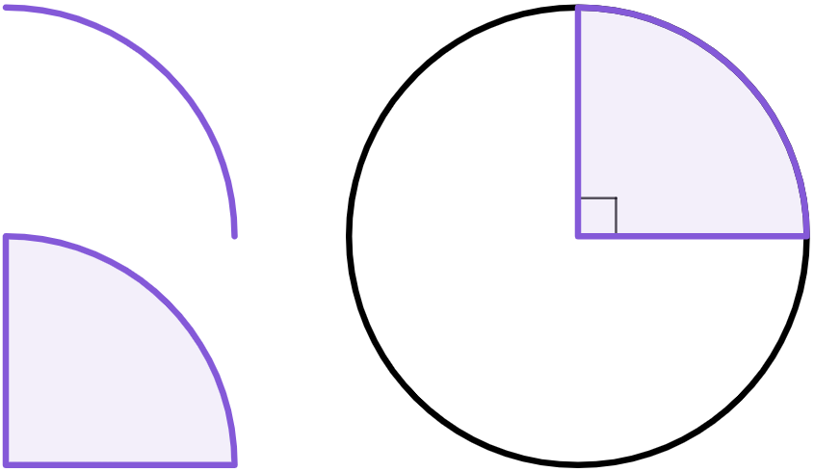
Comparing arcs and perimeters of a sector
Match the arc and sector of the circle to its corresponding length and perimeter calculations.
Some calculations do not match with either.
arc
sector
a
d
b
e
r = 10 cm
c
f

Slide 10

Comparing arcs and perimeters of a sector
Match the arc and sector of the circle to its corresponding length and perimeter calculations.
Some calculations do not match with either.
arc
sector
r = 10 cm
r = 10 cm
d
b
e
r = 10 cm

Slide 11
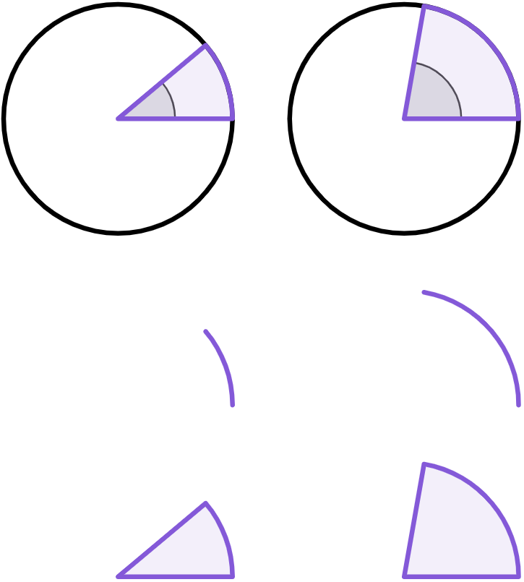

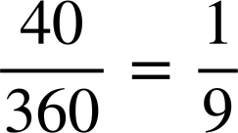

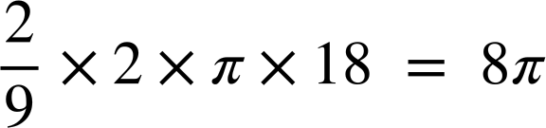
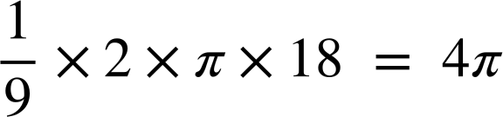

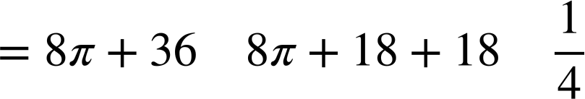
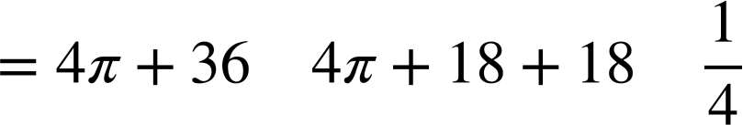
Comparing arcs and perimeters of a sector
Is Aisha’s statement correct?
of a full circle
of a full circle
80°
40°
If I double the size of the angle in this sector, the perimeter of the sector will also double.
18 cm
18 cm
arc length
arc length
perimeter
perimeter
If the angle of a sector doubles, then the arc length also doubles.
= 61.1 cm
= 48.6 cm

Slide 12
Comparing arcs and perimeters of a sector
of a full circle
of a full circle
80°
40°
18 cm
18 cm
arc length
arc length
Aisha is incorrect.
Whilst the arc length doubles, the sector’s perimeter is less than double.
perimeter
perimeter
= 61.1 cm
= 48.6 cm

Slide 13
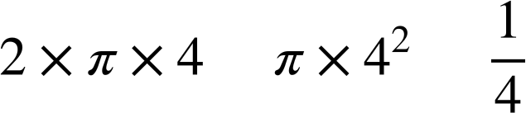
Comparing arcs and perimeters of a sector
1) The arc and sector are congruent to the one on the circle.
Complete each statement with both a calculation and an answer shown on the right.
4 cm
The arc length is
______________
= _______
The perimeter of this sector is
______________
The circumference of this circle is
______________
= _______

Slide 14
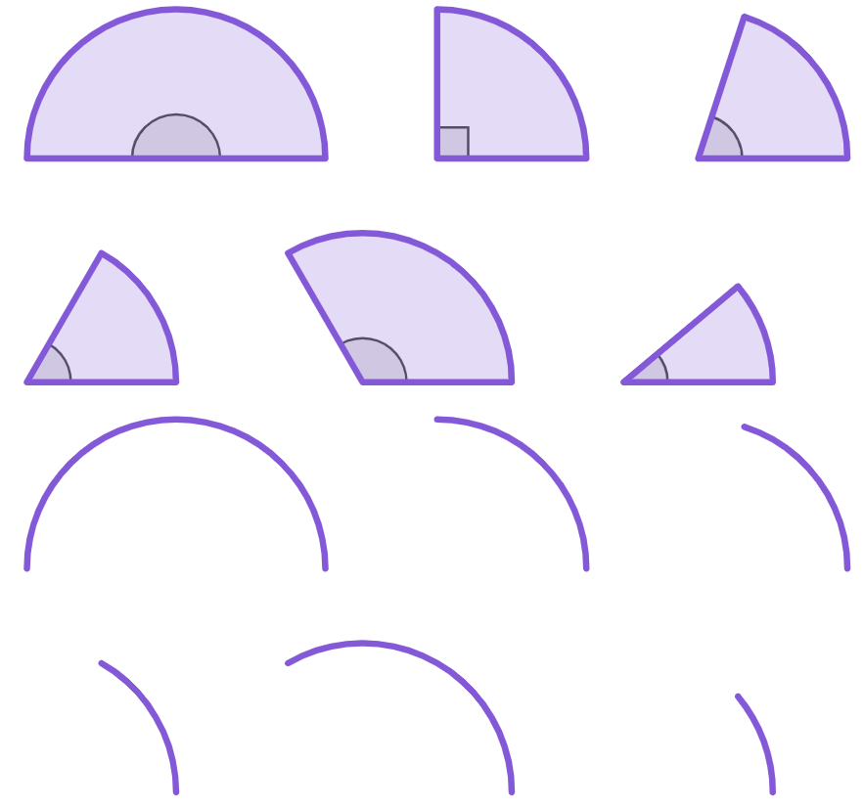
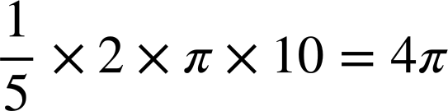
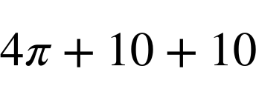
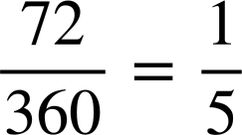
Comparing arcs and perimeters of a sector
2) Complete the table. Leave your answers in terms of π.
arc | corresponding sector | fraction of a full circle | calculations for arc length | calculations for perimeter of sector
a)
180°
6 cm
6π + 12
b)
16 cm
c)
72°
10 cm

Slide 15
Comparing arcs and perimeters of a sector
2) Complete the table. Round your answers to 1 decimal place.
arc | corresponding sector | fraction of a full circle | calculations for arc length | calculations for perimeter of sector
d)
60°
24 cm
73.1 cm
e)
120°
27 cm
56.5 cm
f)
40°
45 cm

Slide 16
Comparing arcs and perimeters of a sector
1) The arc and sector are congruent to the one on the circle.
Complete each statement with both a calculation and an answer shown on the right.
4 cm
The arc length is
=
The perimeter of this sector is
The circumference of this circle is
=

Slide 17

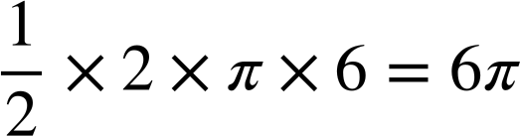
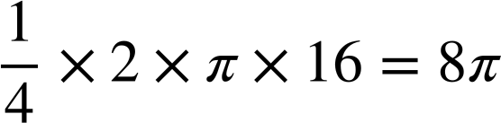

Comparing arcs and perimeters of a sector
2) Complete the table. Leave your answers in terms of π.
arc | corresponding sector | fraction of a full circle | calculations for arc length | calculations for perimeter of sector
a)
180°
6π + 6 + 6
6 cm
6π + 12
b)
8π + 16 + 16
8π + 32
16 cm
c)
72°
4π + 20
10 cm

Slide 18
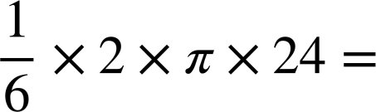

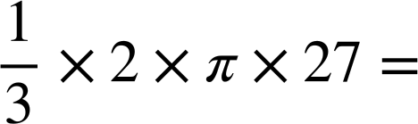
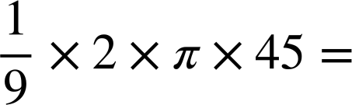

Comparing arcs and perimeters of a sector
2) Complete the table. Round your answers to 1 decimal place.
arc | corresponding sector | fraction of a full circle | calculations for arc length | calculations for perimeter of sector
d)
25.1 + 24 + 24 =
60°
24 cm
25.1 cm
73.1 cm
e)
56.5 + 27 + 27 =
120°
27 cm
56.5 cm
110.5 cm
f)
31.4 + 45 + 45 =
40°
45 cm
31.4 cm
121.4 cm

Slide 19
Perimeter of composite shapes
Comparing arcs and perimeters of a sector
Finding perimeters of closed composite shapes

Slide 20
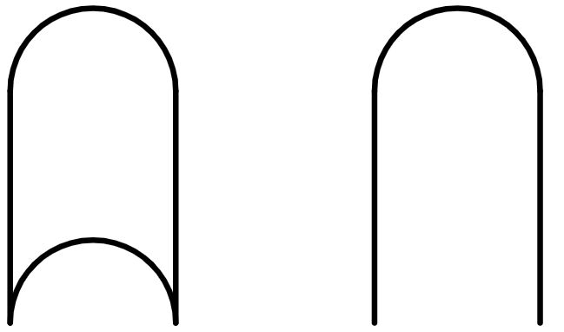
Finding perimeters of closed composite shapes
Composite shapes may be made from combinations of quadrilaterals and sectors of circles.
If you travel along the perimeter of a closed composite shape you will get back to your starting point without travelling any part of the perimeter twice.
example of a closed shape
example of an open (non-closed) shape

Slide 21

Finding perimeters of closed composite shapes
To calculate the perimeter of a closed composite shape, you can break it up into the lengths of its component parts.
3 cm
10 cm

Slide 22
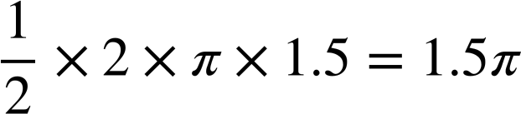
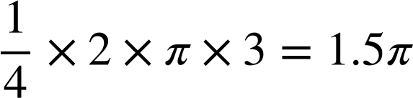
Finding perimeters of closed composite shapes
To calculate the perimeter of a closed composite shape, you can break it up into the lengths of its component parts.
length of semicircular arc
1.5 cm
semicircle
3 cm
length of quarter-circle arc
10 - 3
7 cm
10 cm
10 cm
total perimeter
1.5π + 1.5π + 10 + 7
3 cm
= 3π + 17
quarter-circle
= 26.4 cm

Slide 23

Finding perimeters of closed composite shapes
Calculate the perimeter of this composite shape by breaking it into the lengths of its component parts.
Calculate the perimeter of this composite shape by breaking it into the lengths of its component parts.
This composite shape is made from:
two straight lines of equal length
two semicircles with an equal radius
14 cm
22 cm

Slide 24
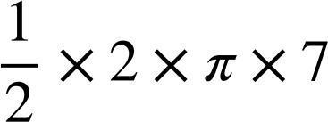
Finding perimeters of closed composite shapes
7 cm
arc length of semicircle
Firstly, sketch the component lengths of the shape.
= 7π
Then, label the lengths of all straight lines.
14 cm
arc length of other semicircle
And the radii of all circle sectors.
Next, calculate the arc length of all circle sectors.
14 cm
= 7π
7 cm
Finally, add on the lengths of all straight lines.
total perimeter
7π + 7π + 14 + 14
= 14π + 28
14 cm
22 cm

Slide 25
Finding perimeters of closed composite shapes
7 cm
arc length of semicircle
11 cm
arc length of semicircle
= 7π
= 11π
14 cm
22 cm
arc length of other semicircle
arc length of other semicircle
14 cm
22 cm
= 11π
= 7π
7 cm
11 cm
total perimeter
total perimeter
7π + 7π + 14 + 14
= 22π + 44
= 14π + 28
14 cm
22 cm

Slide 26
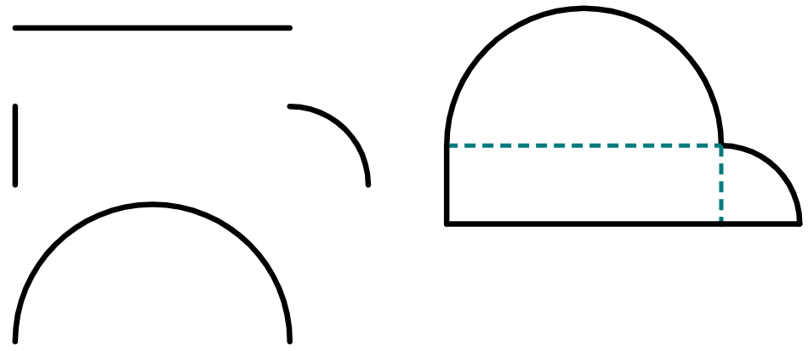
Finding perimeters of closed composite shapes
Which of these are component lengths of this composite shape?
a
b
7 cm
3.5 cm
3.5 cm
2 cm
c
d
e
f
2 cm
7 cm
2 cm
3.5 cm
g
h
2 cm
3.5 cm

Slide 27
Finding perimeters of closed composite shapes
For each component, write down how many copies there are on the composite shape.
a
1 copy (bottom)
7 cm
2 cm
2 copies
(left and bottom right)
b
2 cm
c
1 copy (top)
7 cm
3.5 cm
d
1 copy (right)
2 cm

Slide 28
Finding perimeters of closed composite shapes
Hence, calculate the perimeter of this shape, leaving your answer in terms of π.
7 cm
7 cm
2 cm
4 cm
× 2 copies
2 cm
3.5π cm
7 cm
3.5 cm
total perimeter
4.5π + 11 cm
π cm
2 cm

Slide 29
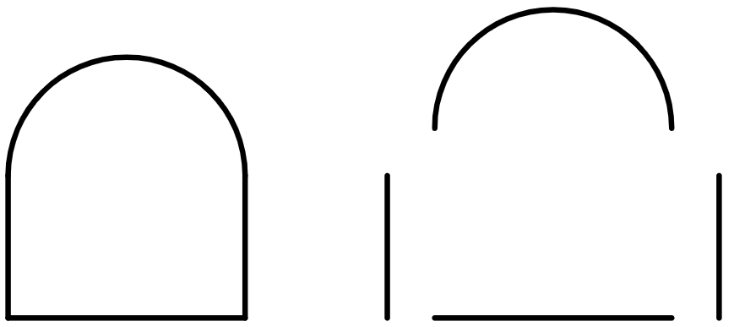
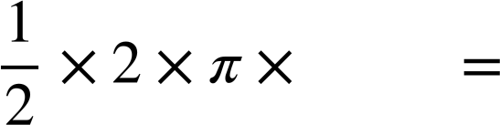
Finding perimeters of closed composite shapes
1) The composite shape has been broken down into its component lengths.
a) Write down the length of all three of these straight lines.
10 cm
b) What is the radius of this semicircle?
8 cm
c) Complete this calculation to find the arc length of this semicircle.
_____
_____
d) Hence, find the total perimeter of this shape.

Slide 30
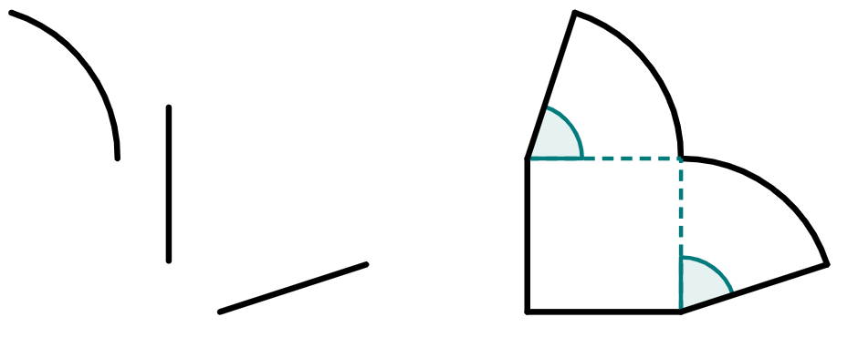
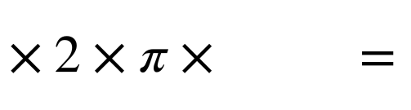
Finding perimeters of closed composite shapes
2) The composite shape has been broken down into its component lengths.
a) Write down the length of all four of these straight lines.
72°
72°
b) What fraction of a full circle do each of these arcs represent?
15 cm
c) Complete this calculation to find the arc length of each arc.
___
_____
_____
d) Hence, find the total perimeter of this shape.

Slide 31
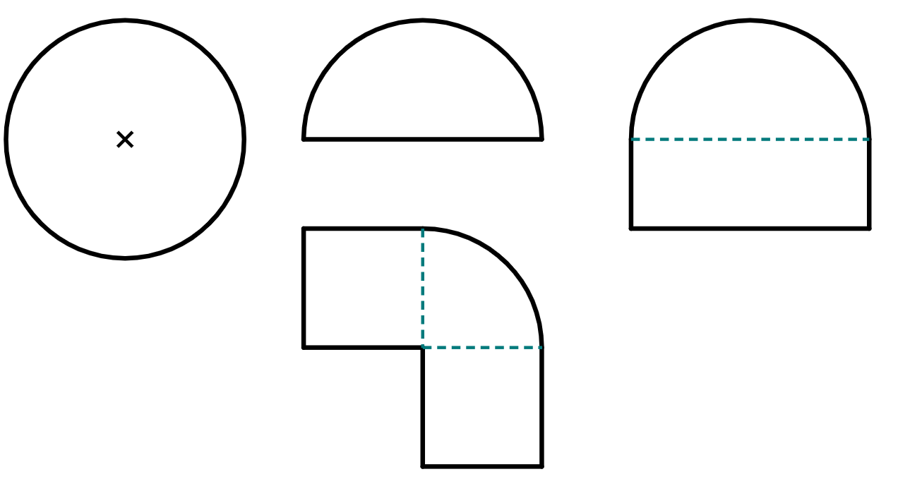
Finding perimeters of closed composite shapes
3) Starting with the smallest perimeter, sort these shapes in terms of the size of their perimeters.
b
a
8 cm
4 cm
d
4 cm
c
4 cm
4 cm
3 cm
8 cm

Slide 32
Finding perimeters of closed composite shapes
1) The composite shape has been broken down into its component lengths.
10 cm
10 cm
a) Write down the length of all three of these straight lines.
8 cm
10 cm
b) What is the radius of this semicircle?
4 cm
8 cm
c) Complete this calculation to find the arc length of this semicircle.
4
4π
_____
_____
d) Hence, find the total perimeter of this shape.
4π + 28 cm

Slide 33
Finding perimeters of closed composite shapes
2) The composite shape has been broken down into its component lengths.
a) Write down the length of all four of these straight lines.
72°
15 cm each or 60 cm total
72°
b) What fraction of a full circle do each of these arcs represent?
15 cm
⅕ each, or ⅖ for both
c) Complete this calculation to find the arc length of each arc.
1
___
15
6π
_____
_____
5
d) Hence, find the total perimeter of this shape.
12π + 60

Slide 34
Finding perimeters of closed composite shapes
3) Starting with the smallest perimeter, sort these shapes in terms of the size of their perimeters.
b
a
4π + 8 = 20.6 cm
8π = 25.1 cm
4 cm
8 cm
d
2π + 24 = 30.3 cm
4 cm
c
4π + 14 = 26.6 cm
4 cm
4 cm
3 cm
b
a
c
d
8 cm

Slide 35
Perimeter of composite shapes
The perimeter of a sector is the arc length plus the lengths of the two radii that bound the sector.
You can use proportional reasoning to find the length of an arc.
To find the perimeter of a composite shape, you can break the shape up into its composite lengths, calculate arc lengths, and then sum together all the lengths.

Slide 36

© Oak National Academy 2023.
Produced in partnership with Mathematics in Education and Industry.
Licensed on the Open Government Licence v3.0, except where otherwise stated. See Oak terms and conditions.

